Slide 1
Somos Valencia
CLASS OF 2021

Slide 2
CLASS of 2021 Graduation Requirements
4 units of English
4 units of Math (one unit equal to or greater than Algebra II)
3 units of Science (must include 2 lab sciences)
3.5 units of Social Studies
.5 Health Elective
1 unit PE
8 units of Electives
24 total credits including one Pre-AP, AP, DC, OR DL

Slide 3
Apex Credit Recovery
All students who need Credit Recovery are enrolled in a 1st period Credit Recovery Class.
Access to teacher support via Zoom and Canvas
All APEX Credit Recovery is due by April 30th for May Graduation.

Slide 4
Testing Requirements
NO TESTING REQUIREMENTS for the Class of 2021.

Slide 5
Getting Help!
KHAN Academy
Ask Teachers!!!
Office Hours!!
El Portal

Slide 6
College Applications
Recommend all students apply to at least one NEW MEXICO College or University!
Visit College websites, most Colleges and Universities accept applications online.
Take College Entrance Exam: ACT or SAT for class placement.
ACT Fee Waivers available for Students who qualify for Free or Reduced Lunch.
Sign up for the ACT at act.org

Slide 7
Financial Aid
To apply for federal student aid, complete the Free Application for Federal Student Aid (FAFSA).
By completing FAFSA, you will automatically be considered for federal student aid. In addition, your state and college may use your FAFSA information to determine your eligibility for nonfederal aid.
Completing the FAFSA is an easy process, and it’s completely free. We recommend submitting your FAFSA online, as your application will process within 3-5 days. You can submit a paper FAFSA, which processes within 7-10 days.
For help with the FAFSA, you can go to http://studentaid.ed.gov.

Slide 8
Scholarship Resources
Students can visit our Valencia High School Counseling Canvas page.
Scholarship list is updated regularly.
Visit college campus websites.
WUE scholarship for reduced tuition in other western states. https://wuesavingsfinder.wiche.edu/
FASTWEB https://www.fastweb.com/

Slide 9
Bridge Scholarship
The Bridge Scholarship is available to students who graduate from a New Mexico High School, and attend a public New Mexico College or University full-time.
First semester award, a “Bridge” to the Lottery.
Contact Financial Aid Office to apply.

Slide 10
Lottery Scholarship
Students have ONE semester to qualify for the Lottery Scholarship.
MUST be enrolled in public university full time (12-15 hours depending on the college).
MUST have a 2.5 GPA or higher.
Not income based.
The Lottery Scholarship is awarded for the second semester of attendance to students who have met all the eligibility requirements during their Qualifying Semester. The scholarship pays up to $2,294 of tuition per semester for the academic year – it does NOT cover mandatory student fees or course fees.

Slide 11
Military Service
Military Recruiters
If your student is interested in joining a branch of the Military, the Counseling department can schedule a meeting with a recruiter during our advisory class.
ASVAB! The ASVAB is a multiple-aptitude test that measures developed abilities and helps predict future academic and occupational success, and is the test used by our Military branches. Contact your Counselor or recruiter to sign up for the ASVAB.

Slide 12
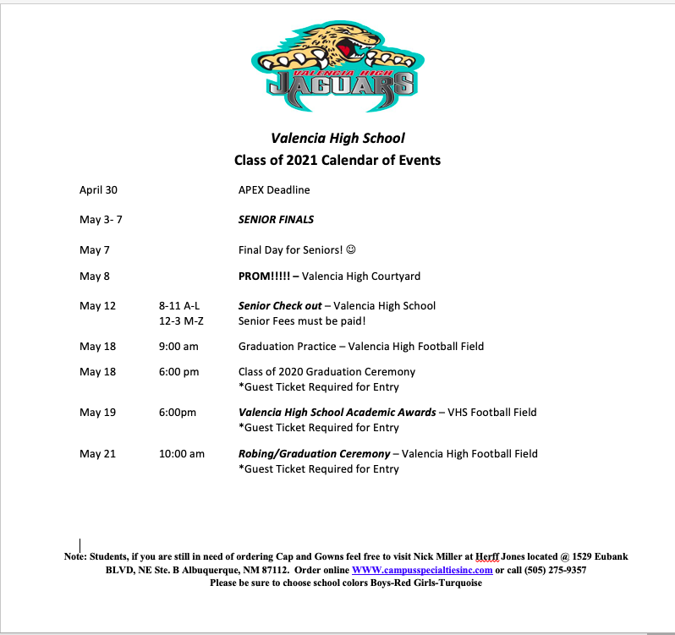

Slide 13
Robing Ceremony Survey!
Link on the “Class of 2021!” Canvas page!! Must be completed by April, 30 to be included in Graduation Program.

Slide 14
Fees and Text Books
All fees are due by Senior Check out Day! Check with Erica Ortega.
All library books and textbooks need to be returned to the library by Senior Checkout Day. Earlier is even better! If a student has lost a book or damaged it beyond repair, the book will need to be paid for or replaced with an identical copy. Mrs. Kastelic will work with students to try to locate replacement copies for a discounted price. Please go to the library or call Mrs. Kastelic for more information.
Lost or damaged books from middle school can also be dropped off at our library, but if there are any fines, those will need to be handled directly with the middle school.

Slide 15
SENIOR CHECK OUT DAY!!
May, 12! A-L 8-11am M-Z 12-3pm
Student must complete Final Next Step Plan to start check out process.
Ensure all Fees are paid!!
Complete drive through check out process!
Request FINAL OFFICIAL TRANSCRIPT.
Receive final signature from Administration.

Slide 16
MACBOOK BUYOUT for Graduating Seniors
Cost $175
Notify Paul Carder by 4/30 if you plan on buying out the MacBook
Turn in MacBook on last day for seniors: 5/7
Receive MacBook back on 5/12 at Senior Checkout
Save files, data will be cleared and Mac will be reset.

Slide 18
Graduation Information
Class Song: Upside Down by Jack Johnson
Class Flower: Orchid
Class Quote: "In response to those who say stop dreaming and face reality, I say keep dreaming and make reality." Kristian Kan
Class Colors: Cherry, Turquoise, and Silver
Cap and Gown Info:
Girls cap and gown color: Turquoise
Boys cap and gown color: Red

Slide 19
Caps & Gowns
www.herffjones.com
All info on the Class of 2021 Canvas Page!

Slide 20
MANDATORY GRADUATION PRACTICE !!
May 18, 9:00 am Valencia Football Field

Slide 21
Graduation
May 21, 2021 !!!

Slide 22
Contact Information
Paul Carder- Assistant Principal pcarder@llschools.net
Rosalyn Montgomery- Senior Counselor rmontgomery@llschools.net
David Olguin-Junior Counselor, Freshman Counselor A-L dlolguin@llschools.net
Joell Himeur- Sophomore Counselor, Freshman Counselor M-Z jhimeur@llschools.net
Sandi Chavez- Registrar (Official Transcripts, ACT & SAT Scores, Diplomas) slchavez@llschools.net
Linda Traganos- Secretary ext. 6227
Dawn Antonio- Senior Class Sponsor dantonio@llschools.net
Erica Ortega– Financial Specialist eortega@llschools.net

Slide 23
Thank you!!
Rosalyn Montgomery

